Slide 1
JS Overview
Single Page Application with Angular
Brygar Ivan & Romanov Alexander
Developer and QA in Sustained Engineering Team
ivb@sitecore.net / arr@sitecore.net October 2014

Slide 2
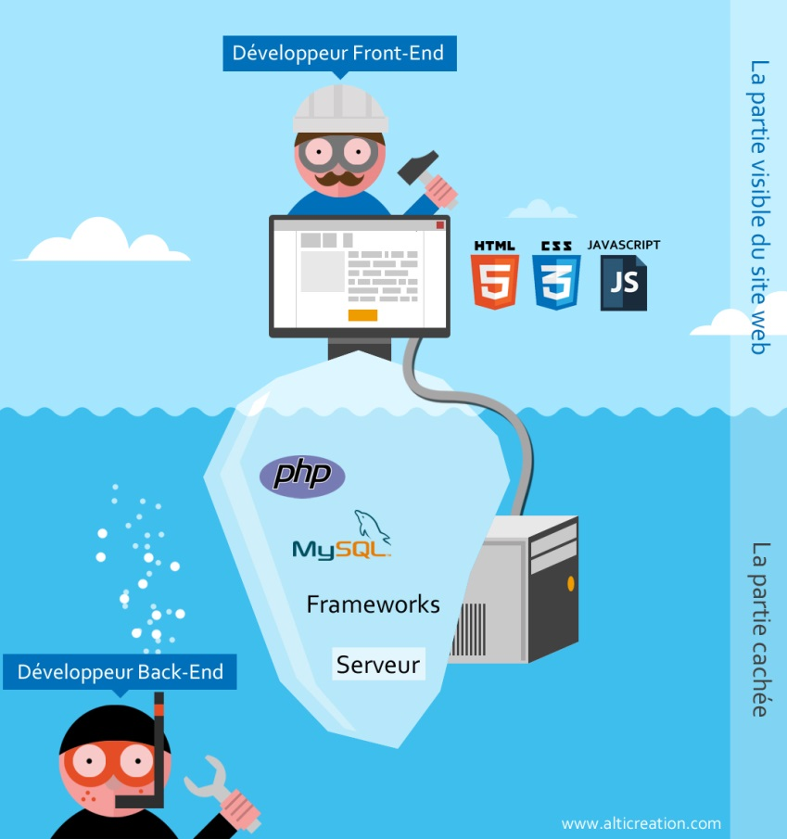
Where is going JS?
Logic in front-end (obviously), but quite complicated than before.
Back-end like a CRUD

Slide 3
Evolution of JS
Few words about OOP
JS don’t have concept of class, but have objects.
Programming with functions and objects (example: C# - programming with classes and objects)
ES 6 is coming…
new keywords: class, public, private, import (similar to using, works even through http).
Not stable yet, some keywords changing.
Tool ES 6 => ES 5

Slide 4




Evolution of JS
jQuery – fresh breath for developers (encapsulated all difficulties of JS, cross-browser).
JS Frameworks – architecture basement (Knockout, Backbone, AngularJS, etc).
Angular advantages – everything from the box, if use another frameworks, need to combine with another libraries.

Slide 5
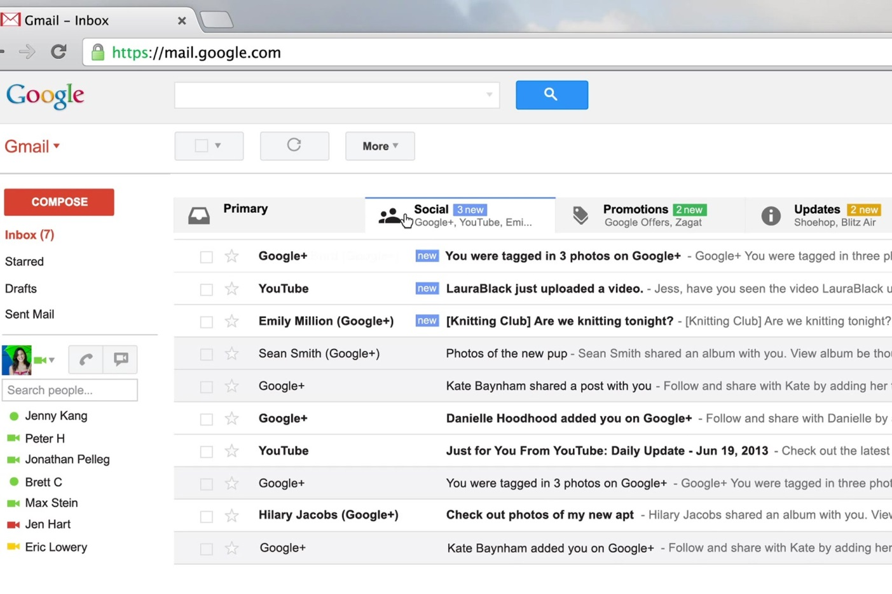
Single Page Application (SPA)
Frameworks helps create SPA application.
Example of SPA.
Advantages (No Page Refresh - websites surely are extremely responsive, Mobile Preferred, Better Google PageRank)
Disadvantages - ?

Slide 6

JS and SEO
Minification, Uglification – load time and count of files is important.
CDN
Tools:
UglifyJS
Google Closure Tools
YUI Compressor

Slide 7


JS in back-end (NOT DONE YET)
Few words about Node.js
What is it NPM?

Slide 8

JS automation
Few words about Grunt, how it helps?
In one word: automation. The less work you have to do when performing repetitive tasks like minification, compilation, unit testing, linting, etc, the easier your job becomes. After you've configured it through a Gruntfile, a task runner can do most of that mundane work for you—and your team—with basically zero effort

Slide 9

JS scaffolding
Yeoman (written by Node.js)
Yes, it’s possible install Yeoman from npm. (npm install yeoman)
Help developers quickly build high quality web applications

Slide 10


JS only for Web?
Ionic framework - open source front-end framework for developing hybrid mobile apps with HTML5.
PhoneGap - open source framework that allows you to create mobile apps using standardized web APIs for the platforms you care about

Slide 11

Protractor? What is it?
Protractor is an end to end test framework for AngularJS applications built on top of WebDriverJS. Protractor runs tests against your application running in a real browser, interacting with it as a user would

Slide 12
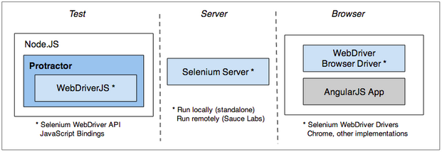
Protractor. Under the hood.
Protractor works in conjunction with Selenium to provide an automated test infrastructure that can simulate a user’s interaction with an Angular application running in a browser or mobile device
Protractor is a wrapper around WebDriverJS, the JavaScript bindings for the Selenium WebDriver API
Your test scripts send commands to the Selenium Server, which in turn communicates with the browser driver

Slide 13
Protractor? Is it support my favorite Internet Explorer?
Driver | Support | Known Issues
ChromeDriver | Yes
FirefoxDriver | Yes | #480 clicking options doesn't update the model
SafariDriver | Yes | #481 minus key doesn't work, SafariDriver does not support modals, #1051 We see occasional page loading timeouts
IEDriver | Yes | #778, can be slow, #1052 often times out waiting for page load
OperaDriver | No
ios-Driver | No
Appium - iOS/Safari | Yes* | drag and drop not supported (session/:sessionid/buttondown unimplemented)
Appium - Android/Chrome | Yes*
Selendroid | Yes*

Slide 14
Protractor? Can we ….?
Yes, we can use a bunch of locators: id, css and also Angular related – model, binding, repeater;
Yes, we can configure timeouts;
Yes, we can write a tests with very familiar WebDriver API;
Yes, we can interact with JS directly;
Yes, we can even use a Page Object pattern;

Slide 15

Plan for demo
Build SPA (Single Page Application) step by step
Create tests for SPA using protractor

